Slide 1
Final Project Presentation Project Work <Programme>

Slide 2
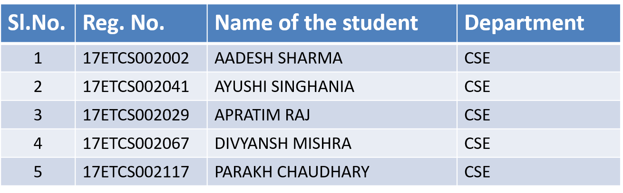
Group Details
Batch : 2017

Slide 3
Title of the Project: DETECTION OF EMOTIONAL STATES BY SPEECH RECOGNIZATION
Supervisors
Supervisor 1: Mr. DEEPAK VARADAM
Place of Work Ramaiah University of Applied Sciences College Campus

Slide 4
Outline
Introduction
Motivation(Project Concept and its relevance)
Aims and Objectives
Title, Aim, Objectives, Methods and Methodology
Problem Solving
Project Concept, Design, Development or Implementation, Testing
Outcomes-
Working Model/Prototype/Tool/Patent/ New Process/ Procedure/ Design/ Technique
Project Costing
Conclusions
References
Demonstration
Workload Allocation
Team Experience
Report Writing and Uploading Product video on YouTube

Slide 5
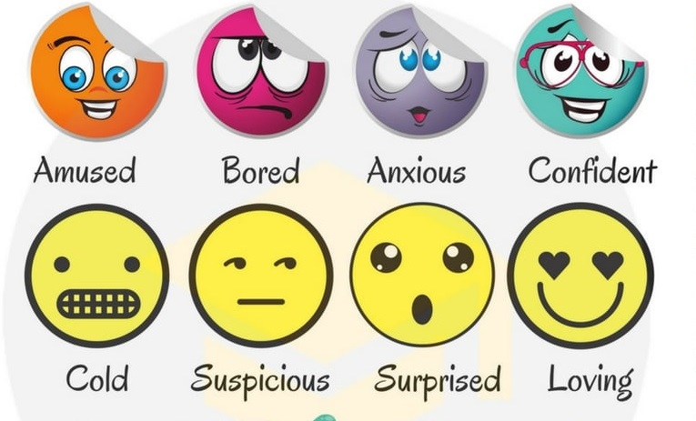
Introduction
Emotions represent the mood of a person. They are influenced by personality and temperament and determine the behaviour of a person, being closely linked to the nervous system.
Emotions are positive or negative experiences that are associated with a particular pattern of psychological activity.

Slide 6
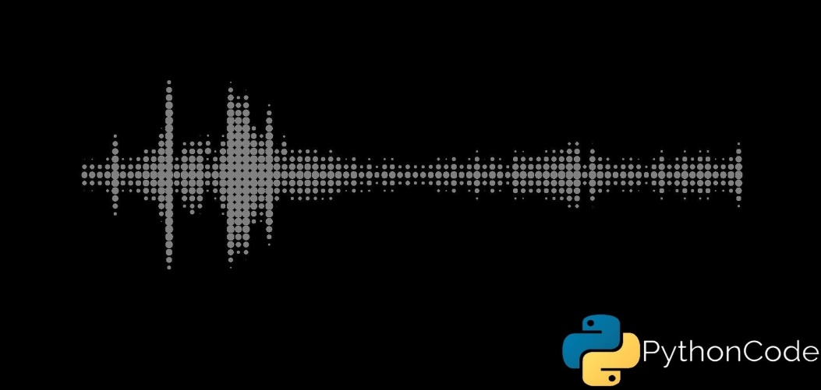
Introduction
Our purpose is to develop a practical mobile application which determines the emotional state of users, based on voice and speech collected from the user.
Such a simplified model will be used in this project to establish the possible emotional state of the user, such as happy, sad, angry, etc.

Slide 7
Motivation (Project Concept and its relevance)
Project Concept:-
This project uses the concept of Speech recognition in order to detect the emotional state of the user:
The speech recognition will be done once a user that accesses the mobile application provides relevant audio.
Relevance:-
The concept of Emotional speech recognition is an area of great interest for human computer interaction. The system must be able to recognize the users emotion and perform the actions specified accordingly. In order to achieve the emotional states of a person when he is talking (by using extraction techniques) which can be very helpful for modern industries, hence this prototype is designed.

Slide 8
Title and Aims
Title:-
Detection of Emotional States by Speech Recognition
Aim:-
Classify the given states of a person by using Speech Recognition.

Slide 9
Objectives
Emotions appear whenever a perception of important changes occurs in the surroundings or in the human body. An emotion is a psychological state or a process that is designed to maintain a balance between the information processed by the brain and the most important goals that the brain must achieve. Therefore, the exploitation of this area is difficult, and the development of applications in this area is based mainly on well-known and extensively tested things.
The most known example of emotions detection application is based on speech recognition. The study of emotions and their change has some major advantages in developing emotional intelligence by developing capabilities to help us better understand automatic reactions of the human body. Unlike gestures or language, the human speech is a universal language that reflects fluctuations of the mood in a person. Understanding how a person reacts helps us improve our social relationships, but also recognize and interpret their emotions better.
Emotional speech recognition is an area of great interest for human computer interaction. The system must be able to recognize the users emotion and perform the actions specified accordingly.

Slide 10
Objectives
To detect and analyse the emotional states of a person by using pitch and frequency features in speech recognition.
Essential to have a framework that includes various modules performing actions like speech to text conversion, feature extraction, feature selection and classification of those features to identify the emotions.
The pitch and Formants are first extracted from the speech signal and then their analysis is carried out to recognize different emotional states as Neutral, Happy, Sad etc.
In taking Voice samples from user to detect the emotional state of the person.
Using pitch and frequency features in speech recognition.
To analyze the features extracted from the voice samples.
To determine the feature of the voice sample and select the state as per input.
To classify the features of voice samples that taken as an input
To store the voice samples in the database for efficient recognition output

Slide 11
Methods and Methodology
Preprocessing
Feature extraction
Feature selection
Classification
Database

Slide 12
Methods and Methodology
In taking Voice samples from user to detect the emotional state of the person.
Preprocessing:
Converting the acoustic sound pressure wave into a digital signal which is suitable for voice processing. A microphone can be used to convert the acoustic wave into an analog signal. This analog signal is passed through ant aliasing filter to compensate for any channel impairments.

Slide 13
Methods and Methodology
Using pitch and frequency features in speech recognition.
Feature extraction:
The next part is to represent the speech signal by a sequence of feature vectors. The speech signal contains a large number of parameters that reflect the emotional characteristics.

Slide 14
Methods and Methodology
To analyze the features extracted from the voice samples
Techniques used:
MFCC Features (Mel-frequency cepstrum coefficient)
These are the best for speech recognition as it takes human perception sensitivity with respect to frequencies into consideration. For each frame, the Fourier transform and the energy spectrum were estimated and mapped into the Mel-frequency scale. The discrete cosine transform (DCT) of the Mel log energies was estimated, and the first 12 DCT coefficients provided the MFCC values used in the classification process.
Techniques used:
MS Features (Modulation spectral features)
These features are obtained by emulating the spectro-temporal (ST) processing performed in the human auditory system and consider regular acoustic frequency jointly with modulation frequency.

Slide 15
Methods and Methodology
To determine the feature of the voice sample and select the state as per input.
Feature selection:
Feature selection (FS) aims to choose a subset of the relevant features from the original ones according to certain relevance evaluation criterion, which usually leads to higher recognition accuracy. It can drastically reduce the running time of the learning algorithms. In this section, we present an effective feature selection method used in our work, named recursive feature elimination with linear regression (LR-RFE).
Techniques used:
LR-RFE (Linear regression-Recursive feature elimination)
Uses a model ( linear regression) to select either the best- or worst-performing feature and then excludes this feature. These estimators assign weights to features (e.g., the coefficients of a linear model), so the goal of recursive feature elimination (RFE) is to select features by recursively considering smaller and smaller sets of features

Slide 16
Methods and Methodology
To classify the features of voice samples that taken as an input
Classification:
Many machine learning algorithms have been used for discrete emotion classification. The goal of these algorithms is to learn from the training samples and then use this learning to classify new observation.
RNN (Recurrent neural networks)
SVM (Support vector machines)

Slide 17
Methods and Methodology
To store the voice samples in the database for efficient recognition output
Database:
The performance and robustness of the recognition systems will be easily affected if it is not well trained with a suitable database. Therefore, it is essential to have sufficient and suitable phrases in the database to train the emotion recognition system and subsequently evaluate its performance.

Slide 18
Problem Solving
The Design we implement in our code are follow:
Collected labelled data.
Created a CNN model with 5 layers.
Trained the model using 80% of available data
Tested the model using 20% of data with a max accuracy of 60% - 70%.
Setting parameters: like sampling rate, window size (choosing one audio from the file)
Setting the labels of feelings.
Getting the features of audio files using Librosa.
Dividing the data into test and train.
Building the model.
Save model and evaluate it on test data.
Test on real world samples.
Detect the Emotion.

Slide 19
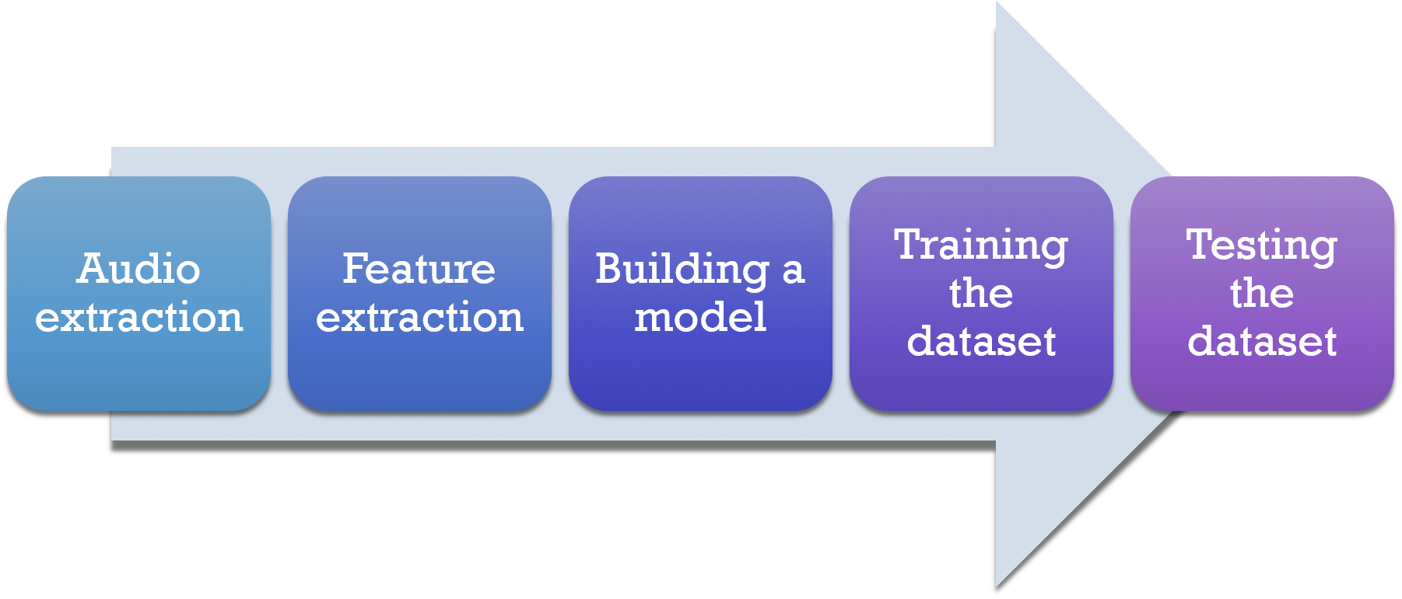
Problem Solving
Raw Figure of design Approach

Slide 20
Data Collection
The data-sets we used to build the train models and for testing are as follow:
The Ryerson Audio-Visual Database of Emotional Speech and Song (RAVDESS).
It is a database comprising of voice samples of 24 actors (12 male, 12 female). The speech of these are in various emotions and all the actors speak in North American English accent.
2) Surrey Audio-Visual Expressed Emotion (SAVEE) Dataset.
SAVEE (Surrey Audio-Visual Expressed Emotion) is an emotion recognition dataset. It consists of recordings from 4 male actors in 7 different emotions, 480 British English utterances in total.

Slide 21
Note:
The datasets which we used have speech voice upto 3 – 5 seconds because we use large amount of files so the data-sets must have smaller memory size.
Google Drive Link of Dataset: https://drive.google.com/drive/folders/1mlZKNEPD5iATFSX5uIaqCOfTG-IZnsOo?usp=sharing

Slide 22
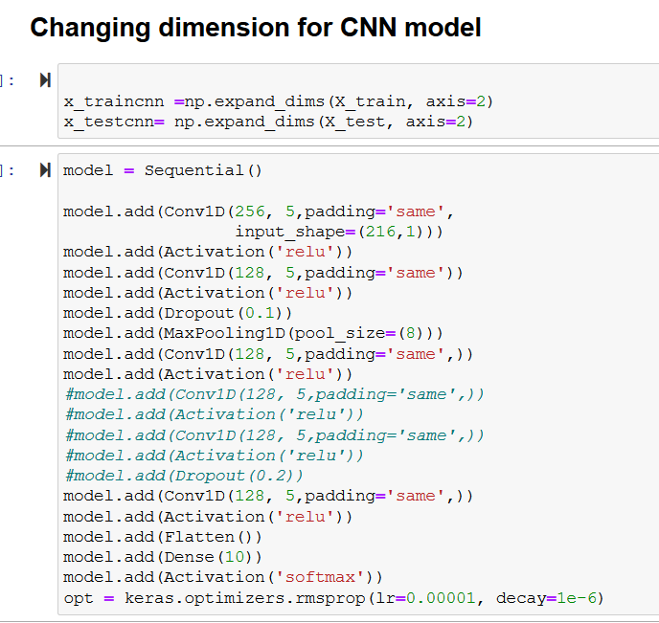
CNN MODEL
We built a LSTM model and CNN models. The MLP and LSTM were not suitable as it gave us low accuracy. As our project is a classification problem where were categorize the different emotions, CNN worked best for us.
So, The Five Layer CNN model which we used to get the accuracy of 70% are as follow:
Coding Implementation of CNN Model.

Slide 23
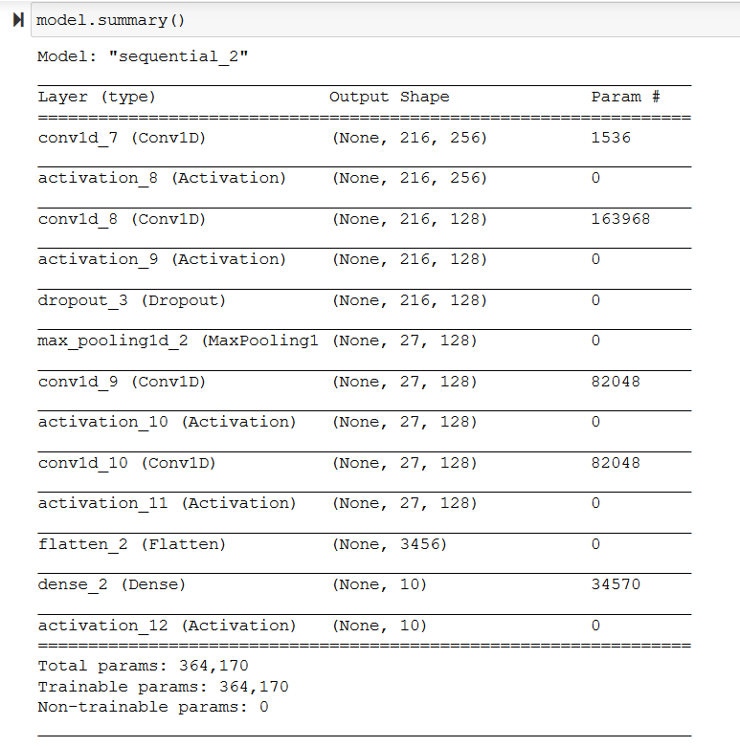
CNN MODEL
Model Summary of the build CNN model

Slide 24
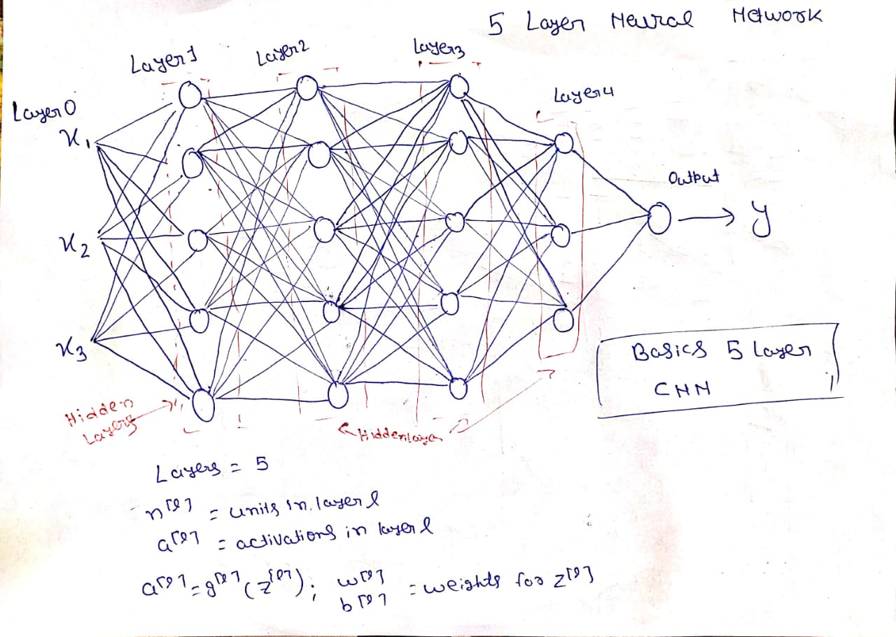
CNN MODEL
The Raw figure of Five layer CNN are as follows:
Five Layer CNN Network.

Slide 25
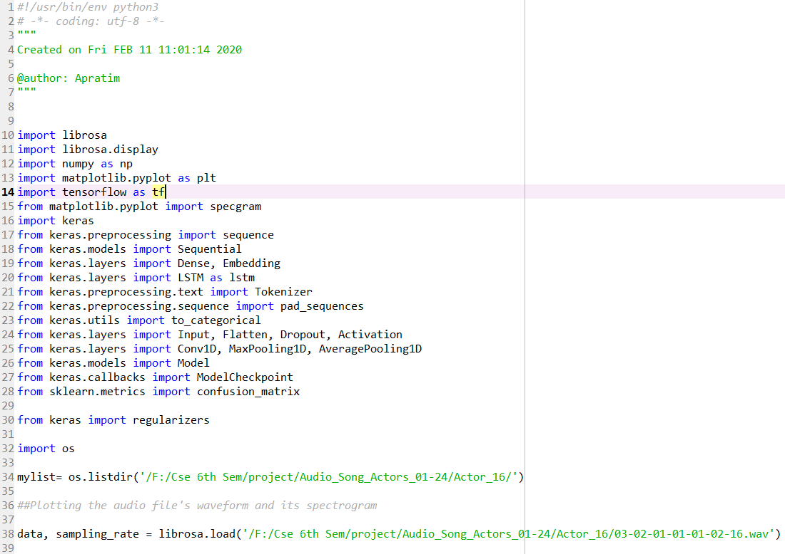
CODE IMPLEMENTATION
Here is the implementation part of our project code. It is the basic design of the emotional speech recognition. Here, we use the python code to implement the project .
The above snippet shows the no of library we import and the files that are use in the project.
We mainly import librosa library, keras, matplotlib, tensorflow etc…

Slide 26
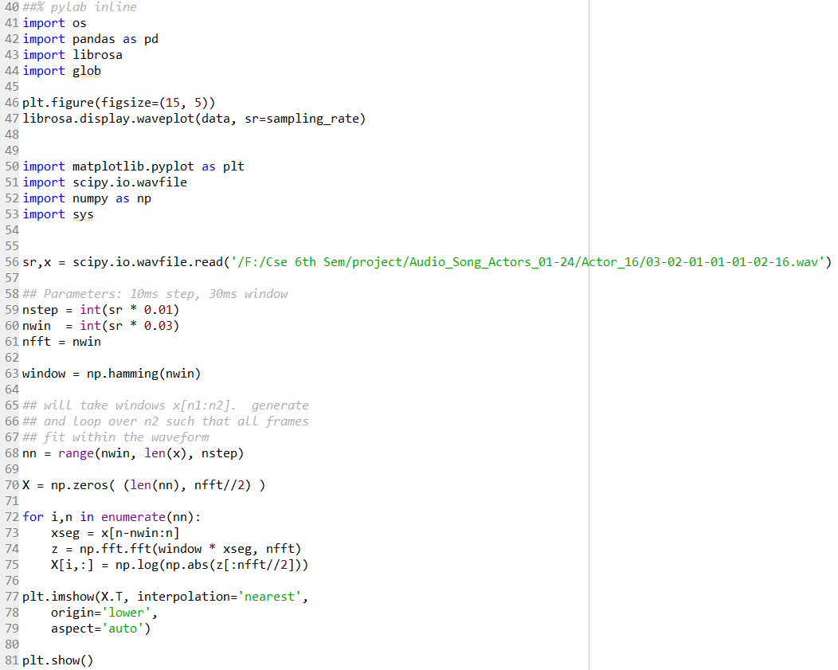
CODE IMPLEMENTATION
Here we import some library and load the raw dataset which we used to detect the emotional states.
Above snippet also shows that we train our datasets.

Slide 27
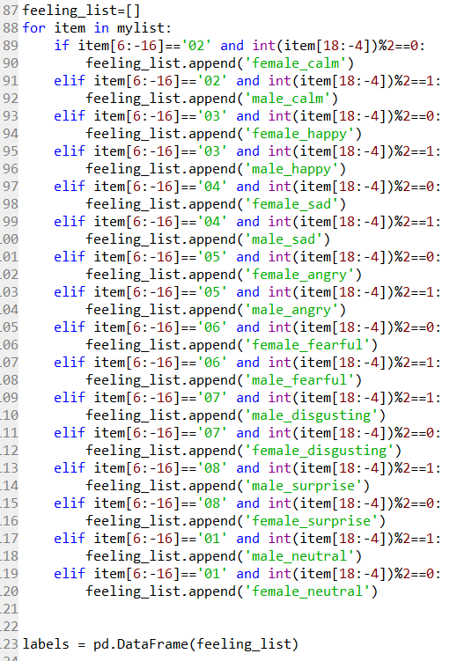
CODE IMPLEMENTATION
Here we classify the feeling or emotional states of the raw data file that we used and train the model to give the efficient states of a person.

Slide 28
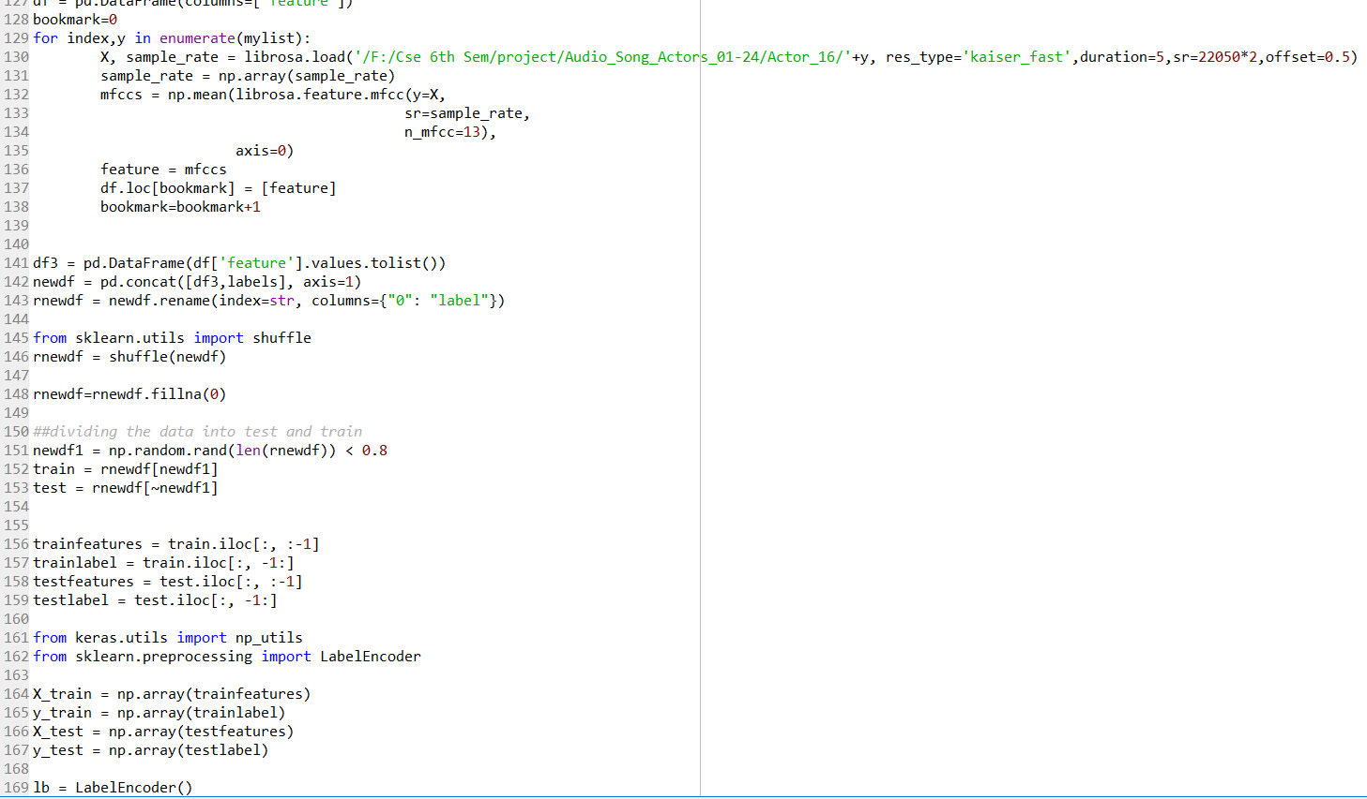
CODE IMPLEMENTATION
Here in the above snippets we basically train the datasets via machine ;earning algorithm.

Slide 29
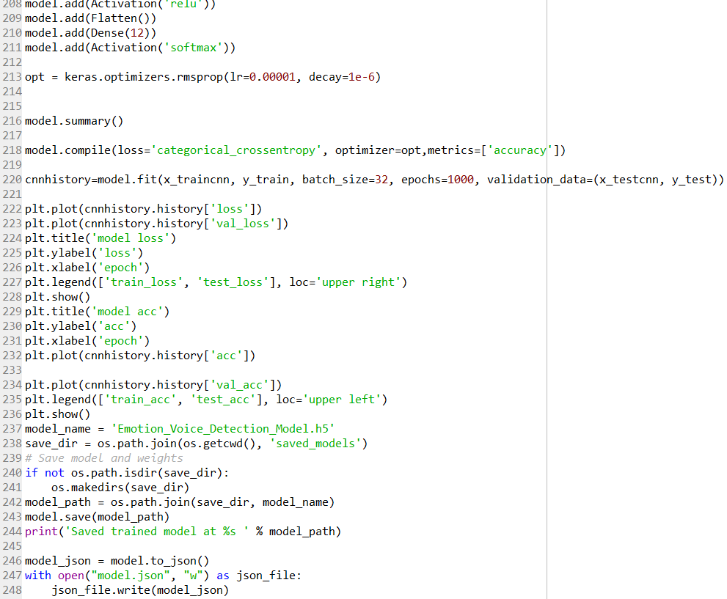
CODE IMPLEMENTATION
Here, we successfully train the datasets via using machine learning algorithm and then store it the Jason file which is used further part of the code which is going to give the expected output.
Also, we are in the initial phase of our project implementation so, here only we show the raw code and the datasets we are used to build the software, Almost half of the implementation is need to be done so, hopefully we will achieve our goal and implement the whole code in the final project.

Slide 30
Problem Solving(Testing)
Test Case ID | Test Case Description | INPUT | Expected Output | Obtained Output | Pass/Fail
TC 01 | Register into the application | Username and password | Registered Successfully | Successful outcome | PASS
TC 02 | Login into the application. | Username & Password | Welcome | Successful outcome | PASS
TC 03 | Login into the application | Username & password | Welcome | Incorrect username or password | Fail
TC 04 | Live prediction of voice using microphone. | Hello I am fine. | Detect the same input speech and neutral emotion. | Successful outcome | PASS

Slide 31
Problem Solving(Testing)
Test Case ID | Test Case Description | INPUT | Expected Output | Obtained Output | Pass/Fail
TC 05 | Live prediction of voice using microphone | Oh! That officer | Detect the same speech and anger emotion. | Successful outcome | PASS
TC 06 | Live prediction of voice using microphone. | Why are you so sad. | Detect the same input speech and sad emotion. | Successful outcome | Pass
TC 07 | Live prediction of voice using microphone. | I am Very Delighted today. | Detect the same input speech and sad emotion. | Successful outcome | Pass
TC 08 | Live prediction of voice using microphone. | This Coffee Sucks. | Detect the same input speech and sad emotion. | Successful outcome | Fail

Slide 32
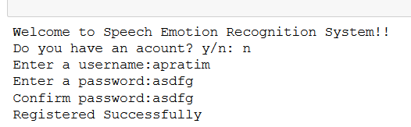
Problem Solving(Testing)
TC01:
Register into the application:
User should register into the application by entering username and password and also confirm the password.
User Registered Successfully.

Slide 33
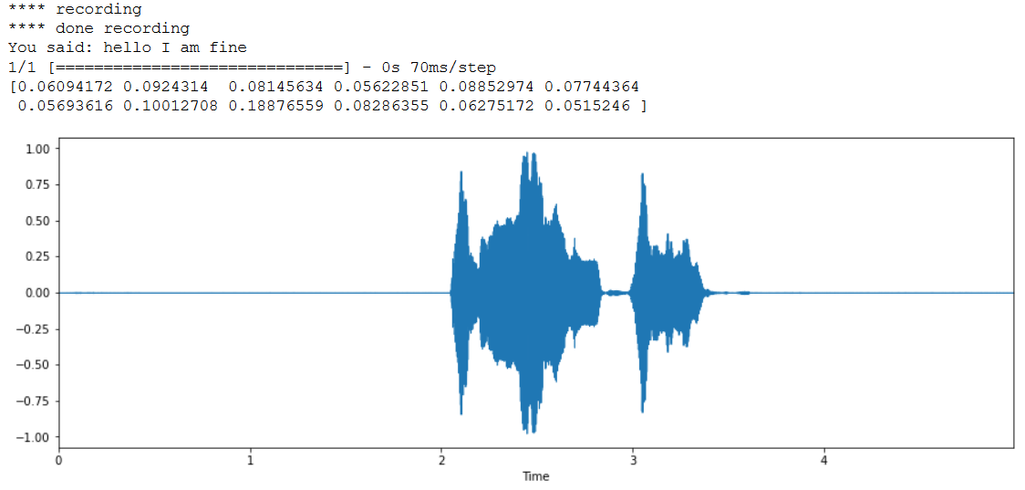
TC 02:
Live prediction of voice using microphone.
User should ask to record the voice of his/her and then after recording it print the speech, Waveform of the output file and detect the emotion.
Recording and waveform of the output file.
Neutral emotion detected successfully

Slide 34
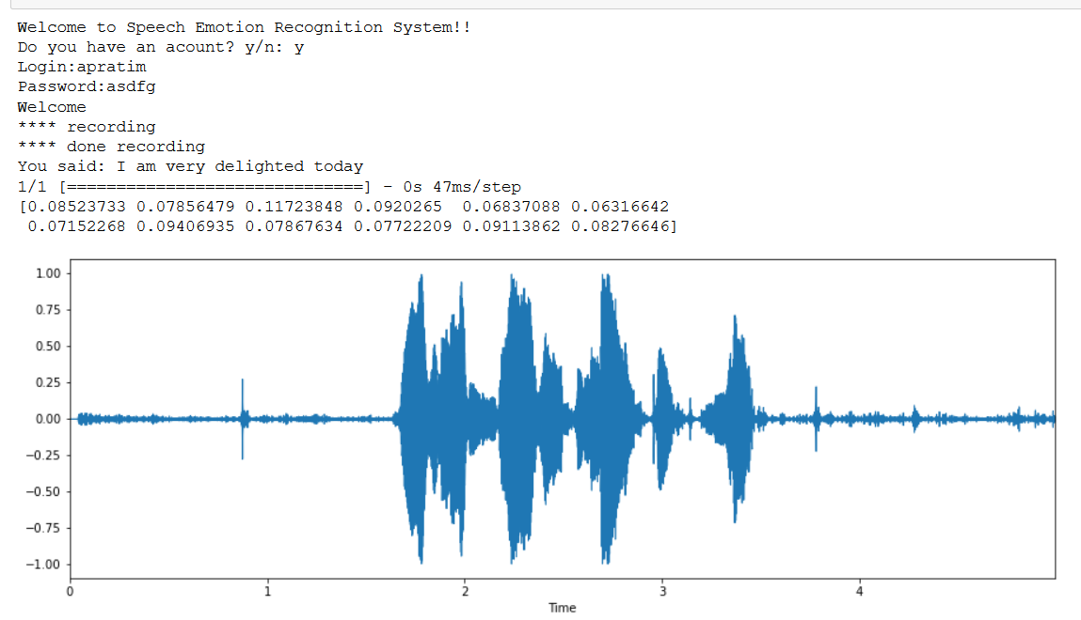

TC 03:
Live prediction of voice using microphone.
User should ask to record the voice of his/her and then after recording it print the speech, Waveform of the output file and detect the emotion.
Recording and The waveform of the output file.
Happy Emotion Detected Successfully.

Slide 35
Outcomes
Here, we are going to test the number of emotions that are detect by our system and for showing this we made a list of tables to replicate this and then analyse the emotions.
Result of the Output File with Correct Emotion Detected.
SNO: | User Voice | Output File | Emotion Detected
1. | Hello I am Fine. | Output.wav | Neutral
2. | I am very Delighted Today | Outout1.wav | Happy
3. | I am going to kill you | Output2.wav | Worry or Sad
4. | Oh! that officer | Output3.wav | Surprised
5. | Why are you so Sad | Output4.wav | Sad

Slide 36
Outcomes
SN0: 1
Here, In this ouput.wav file user recorded the voice Hello I am Fine and the system correctly detected the Speech and correctly detect the emotion is Neutral.
Recording and waveform of the output.wav file.
Neutral Emotion Detected Successfully

Slide 37
Outcomes
Similarly , we detected all other emotions too.the emotions here, we detected are with 70.23% of accuracy. In future if we train the model with large dataset and build a more multilayer CNN to train the model than we get more accuracy and able to get detected more emotion. Thus, the future scope of the model is high.

Slide 38
Project Costing
Component | Quantity | Cost
Software | NA | Rs 0
Hardware | NA | Rs 0
Man Hours | (22 hours * 11 weeks * 5members) = 1210 hours | 1210 man hours
Overall Cost Table.

Slide 39
Conclusions
This project was successfully able to detect emotional state of a person by just listening the voice. The dataset we have taken here are the trained datasets. Our model can detect the emotional state of a person with almost 70.23% of accuracy. The total of 7 different emotions can be detected with such accuracy in this model. In future with some improvements which would lead to greater accuracy this model can be used in the major medical field of mental health. In future, psychiatrists can use this model to detect the conditions of their patients and help them out. We hope that this model will help to shift the current scenario of people dealing with depression to a scenario of mentally happy society in future.

Slide 40
References
Kerkeni, L., Serrestou, Y., Mbarki, M., Raoof, K., Mahjoub, M.A. and Cleder, C., 2019. Automatic Speech Emotion Recognition Using Machine Learning. In Social Media and Machine Learning. IntechOpen.
McGilloway, S., Cowie, R., Douglas-Cowie, E., Gielen, S., Westerdijk, M. and Stroeve, S., 2000. Approaching automatic recognition of emotion from voice: A rough benchmark. In ISCA Tutorial and Research Workshop (ITRW) on Speech and Emotion.
https://github.com/marcogdepinto/Emotion-Classification-Ravdess/blob/master/EmotionsRecognition.ipynb
https://github.com/souravrs999/dark/tree/master/speech_emotion_recognition
https://zenodo.org/record/1188976#__sid=js0

Slide 41
Demonstration
Google Drive link for implementation
https://drive.google.com/drive/folders/1l_JEOwPqkvBVolxpfIgVivh-XeaLzjw1?usp=sharing

Slide 42
Work Load Allocation
 | Aadesh | Ayushi | Apratim | Divyansh | Parakh
Literature survey
Requirement Specification
Design Specification
Development
Testing
Report writing

Slide 43
Team Experience
Our team worked hard to understand the CNN model and its different layers which are created for the model.
Our team designed the application and followed the water fall model to create the application starting with writing the functional and non-functional requirements to implementation ,testing and getting the result .
Our team learned a lot with this project and got familiar with the CNN networks and more flexible with python language.

Slide 44
Thank You

